Slide 1
DEA360 Las Vegas
Addressing the Opioid Crisis From understanding to action

Slide 2
Addressing the opioid crisis -- from understanding to action
How big is this problem?
What are opioids? How are they misused and how do they affect the human brain and body?
What is being done and what can we do?
Notes:
During this presentation we work to answer these questions:
What is the scope of this problem?
What are opioids? How are they misused and how do they affect the human brain and body?
What is being done and what more can we do?

Slide 3
What are heroin and other opioids & How did we get here?
Notes:
I hope you’ll agree that we need change – in our community and across the country. We need to turn the corner on the opioid epidemic and start saving lives and reducing the pain and suffering so many feel.
That journey starts with understanding exactly what heroin and other opioids are and how they work.

Slide 4
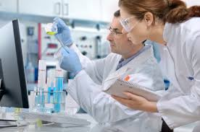
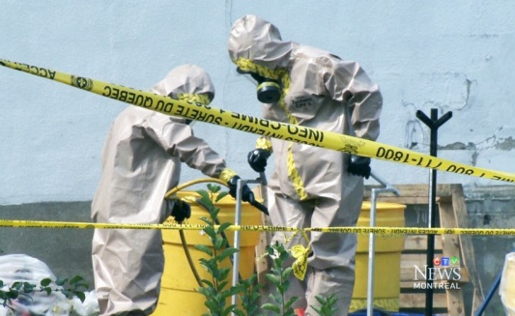
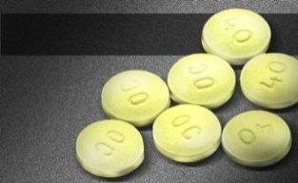
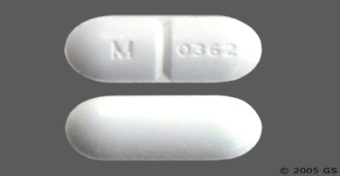
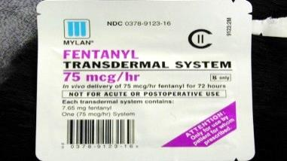
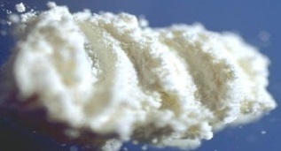
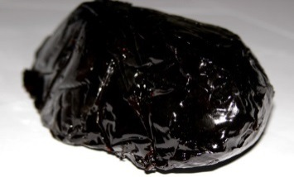
What are opioids?
Opioids* are made from the opium poppy plant or artificially produced to have similar effects. Opioids are depressants.
* Opioids refer to synthetic and organic drugs. Opiates are organic only.
Codeine
Oxycontin
Vicodin
Fentanyl
Powder Heroin
Black Tar Heroin
Notes:
Opioids are chemicals that are either produced from the opium poppy plant or created in a lab to have the same effects. And not all labs are legal ones – the picture on the top right shows a bust of an illicit fentanyl lab in Canada.
Some opioids are medicines. Some are medicines that are produced illicitly. Some are illegal drugs.
They are all very similar at the molecular level … Opioids are central nervous system depressants, which slow down breathing, heart rate, and other bodily functions. Opioids can give a feeling of euphoria, acting on the brain like endorphins, but in a much more powerful way.

Slide 5
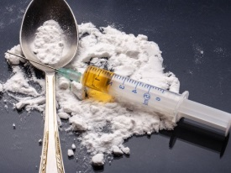
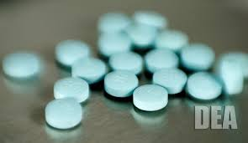
From pills to heroin…
A transition from marijuana and alcohol to heroin (and other drugs) was once less common
Pills provide additional “rungs in the ladder” that make progression toward more addictive drugs more common
50 – 75% of people using heroin started by misusing opioid pills
Notes:
Heroin use among 18-25 year olds doubled and heroin use among those 26 or older tripled.
So, what happened?
Opioid pain relievers played a big part in the increase in use.
[CLICK]
It used to be that it was less common for a person to transition from marijuana or alcohol to drugs like heroin or meth or cocaine.
[CLICK]
Opioid pain medications provided additional “rungs in the ladder” for users to progress towards more serious drugs of misuse.
[CLICK]
This is borne out by the fact that 50-75% of people using heroin started by misusing opioid pills.

Slide 6
Opioid risks
Opioids become even more dangerous when:
Consumed with alcohol, stimulants or sedatives
Combined with other substances
Some add bulk or “cut” heroin
Others, such as illicit fentanyl, change the potency
People misusing opioids don’t know what they’ll get
Notes:
A final point to make about opioids is that they can be even more dangerous when mixed with other substances.
And you can think about that in two ways …
Opioids are dangerous when there are consumed with other drugs such as alcohol or sedatives, or with stimulants. Sometimes users will mix a stimulant like cocaine with a depressant like heroin, which is known as a speedball. The result can be deadly.
Opioids can also become more dangerous when dealers mix heroin with other substances. Some traffickers will mix heroin with a range of substances from flour to chalk. Basically, it’s a way to get more hits our of one kilo of heroin.
But dealers may also try to market themselves by making their heroin more powerful by adding in a drug like fentanyl.
The reality is that a person using opioids may not know what they are going to get.

Slide 7
CDC’s “three waves” of the opioid epidemic
Notes:
The Centers for Disease Control and Prevention have identified three waves of the rise in opioid overdose deaths.
The first, from the late 90’s to mid-2000’s, centered on prescription overdose deaths. The second, from the mid-2000’s to about 2011, was a rise in heroin overdose deaths. We are now in a third wave, when we are seeing an increase in synthetic opioids – the most significant of which is illicit fentanyl.
And, we may be on the cusp of a fourth wave … the DEA is reporting that cocaine and other drugs are contaminated with illicit fentanyl. And if you don’t believe the DEA, Rolling Stone finds the same thing.
https://www.cdc.gov/drugoverdose/epidemic/index.html

Slide 8
Lethal doses of heroin and fentanyl
A lethal dose of heroin,
equivalent to about 30 milligrams, enough to kill an average-sized adult male
With typical dosing for surgery between 50 and 200 micrograms, 2-3 milligrams can be lethal.
www.statnews.com/2016/09/29/ fentanyl-heroin-photo-fatal-doses Photo: NH State Police
Notes:
So – Another way to look at it …
A fatal dose of heroin is about 30 milligrams …
But a lethal dose of fentanyl is only 2-3.
Due to difficulty of mixing fentanyl evenly, the amount of fentanyl in different doses of heroin can vary significantly.
In 2016, one seizure of counterfeit prescription pills had approximately 1.8 milligrams of fentanyl in each pill (DEA).

Slide 9
Why do people misuse opioids?
Notes:
So, when you think about the abscesses and overdoses, you may wonder, why would anyone every use these drugs?

Slide 10
Why do people start misusing opioids?
A person may…
Have been prescribed medications for pain and begin to misuse the medication for reasons other than pain
Develop tolerance to pain pills they are prescribed and begin to increase the dose on their own, or snort or use a needle to increase the effect
Experiment with recreational use due to sensation seeking or coping with emotional stress or pain
Use opioids to counteract the effects of another substance
Like that opioids can give a high without alcohol’s hangover or marijuana’s smell
Notes:
When you ask why people start, there are a basic few answers …
Some people may be prescribed opioids, decide that they like the feeling that it gives, and keep using
Others may develop a tolerance to their prescription … the same amount of drugs doesn’t have the same effect, so they start to misuse their prescription.
Others may try opioids because it’s the next drug on the table – they are a recreational drug user and they want to try something new; or they are suffering from emotional pain and they are seeking relief
For young users, pills may have advantages over alcohol or marijuana – They are easier to hide and don’t have the same signs of use, and don’t give a hangover.
Also when mixed with stimulants can soften the "crash"

Slide 11
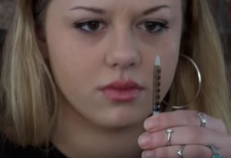
Why do people keep misusing opioids?
The body adapts to opioids – use no longer results in euphoria
Stopping use can result in withdrawal:
First 24 hours: muscle aches; restlessness; anxiety; teary eyes; runny nose; excessive sweating; inability to sleep; yawning
Next 48 hours: diarrhea; abdominal cramping; goose bumps on the skin; nausea and vomiting; dilated pupils and possibly blurry vision; rapid heartbeat; high blood pressure
Relapse – using opioids after a period of abstinence – is especially concerning
Notes:
A reality is that, over time, the reward system breaks down. Use no longer results in euphoria.
So why do people keep using?
One of the biggest reasons is withdrawal -- the physical response to not using opioids after a person becomes addicted..
You can see all the ways in which the body tries to return to the way things were before use started. In a lot of ways, the pendulum swings too far.
Where a opioids can make a user lethargic, in withdrawal a person may not be able to sleep. Pinpoint pupils become dilated pupils
Opioids can make a person constipated … In withdrawal the intestinal system is reopened which can lead to diarrhea and vomiting.
A user goes from a slow, weak heartbeat to a rapid heartbeat and high blood pressure.
Relapse is also a significant concern. If a user goes back to using opioids after a period of abstinence they may use the same amount of drugs as they did before. Their body may not be ready for that level of use and they can die.

Slide 12
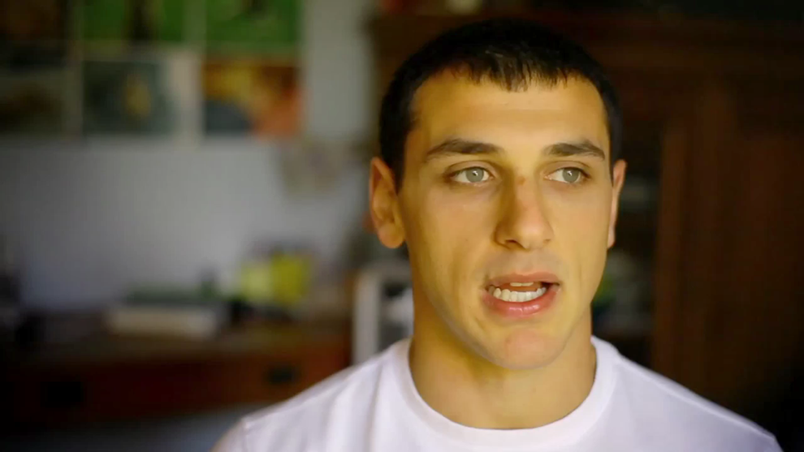
Nacho
Notes:
In this video, a young man, Nacho talks about his experience with withdrawal.

Slide 13
Nacho

Slide 14
What does a opioid overdose look like?
Pinpoint pupils always present
Awake, but unable to talk
Fingernails and lips turn blue or purplish black
For lighter skinned people, the skin tone turns bluish purple, for darker skinned people, it turns grayish or ashen.
Notes:
Pinpoint pupils always present
Awake, but unable to talk
Fingernails and lips turn blue or purplish black
For lighter skinned people, the skin tone turns bluish purple, for darker skinned people, it turns grayish or ashen.
Breathing is very slow (less than 6 breaths / minute) and shallow, erratic or has stopped
Pulse (heartbeat) is slow, erratic or not there at all
Choking sounds or a snore-like gurgling noise (sometimes called the “death rattle”)
Unresponsive to outside stimulus
Naloxone / Narcan can reverse an overdose, BUT ALWAYS CALL 911

Slide 15
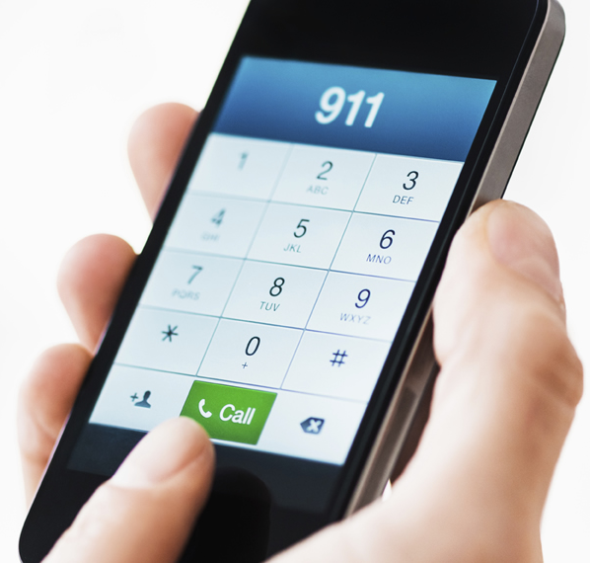
What does a opioid overdose look like?
Breathing is very slow (less than 6 breaths / minute) and shallow, erratic or has stopped
Pulse (heartbeat) is slow, erratic or not there at all
Choking sounds or a snore-like gurgling noise (sometimes called the “death rattle”)
Unresponsive to outside stimulus
Naloxone / Narcan can reverse an overdose, BUT ALWAYS CALL 911
Notes:
Pinpoint pupils always present
Awake, but unable to talk
Fingernails and lips turn blue or purplish black
For lighter skinned people, the skin tone turns bluish purple, for darker skinned people, it turns grayish or ashen.
Breathing is very slow (less than 6 breaths / minute) and shallow, erratic or has stopped
Pulse (heartbeat) is slow, erratic or not there at all
Choking sounds or a snore-like gurgling noise (sometimes called the “death rattle”)
Unresponsive to outside stimulus
Naloxone / Narcan can reverse an overdose, BUT ALWAYS CALL 911

Slide 16
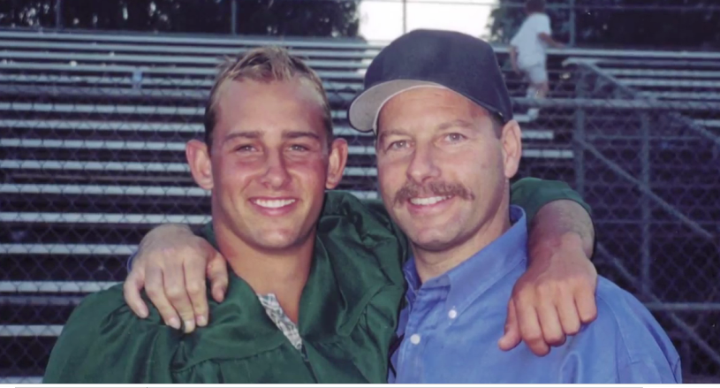
Aaron
Notes:
The next video you will see is the story of a young man named Aaron and his family. Aaron used prescription drugs at a party at a friend’s house. He had an overdose. His friend’s mom waited to call 911, hoping he would come out of it. That wait resulted in a loss of oxygen to Aaron’s brain.

Slide 17
Aaron

Slide 18
What individuals and communities can do
Notes:
Now that we have a better understanding of opioids, let’s talk about what can be done … by individuals and by communities to address this threat

Slide 19
What’s happening
Notes:
But before we list all of the actions that can be taken it is important to recognize the work that is being done and to point out how that work can be made even better.

Slide 20
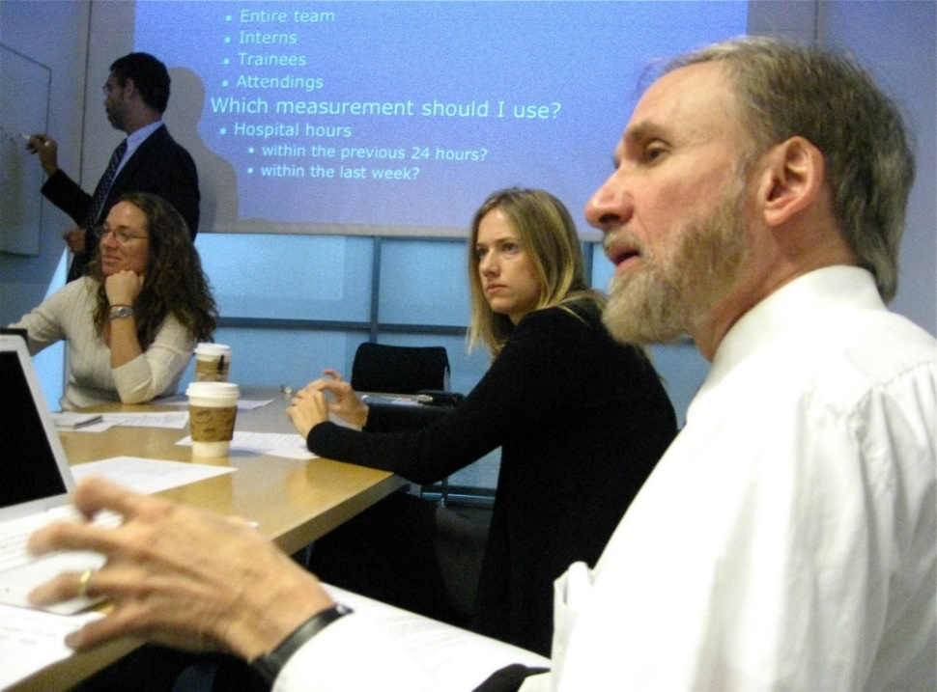
Prescriber education …
Many medical professionals lack training in prescribing and substance use disorders
Since 2015, more than 118,000 physicians have taken educational courses related to opioid prescribing and pain management
Federal health officials are being trained
More work to be done …
Make training in addiction and pain management standard practice for new and existing doctors
Notes:
The first step is prescriber education …
It is a fair criticism that opioid painkillers have been overprescribed by doctors over the last decade. Many of us have gone to the doctor or dentist and been given a prescription for 30 pills when we really only needed two or three. But medical professionals need to use their knowledge as professionals to help their patients in the best way that they know how.
That is why prescriber education is so important and why the federal government and other organizations are making a commitment to expand and improve prescriber education.
[CLICK]
However, there is more work to be done …
Quality prescriber education for new and existing medical professionals needs to be standard practice. We also need to expand training in addictions for doctors … right now most medical professionals only receive a small amount of information about identifying and helping patients who are suffering from substance use disorders.

Slide 21
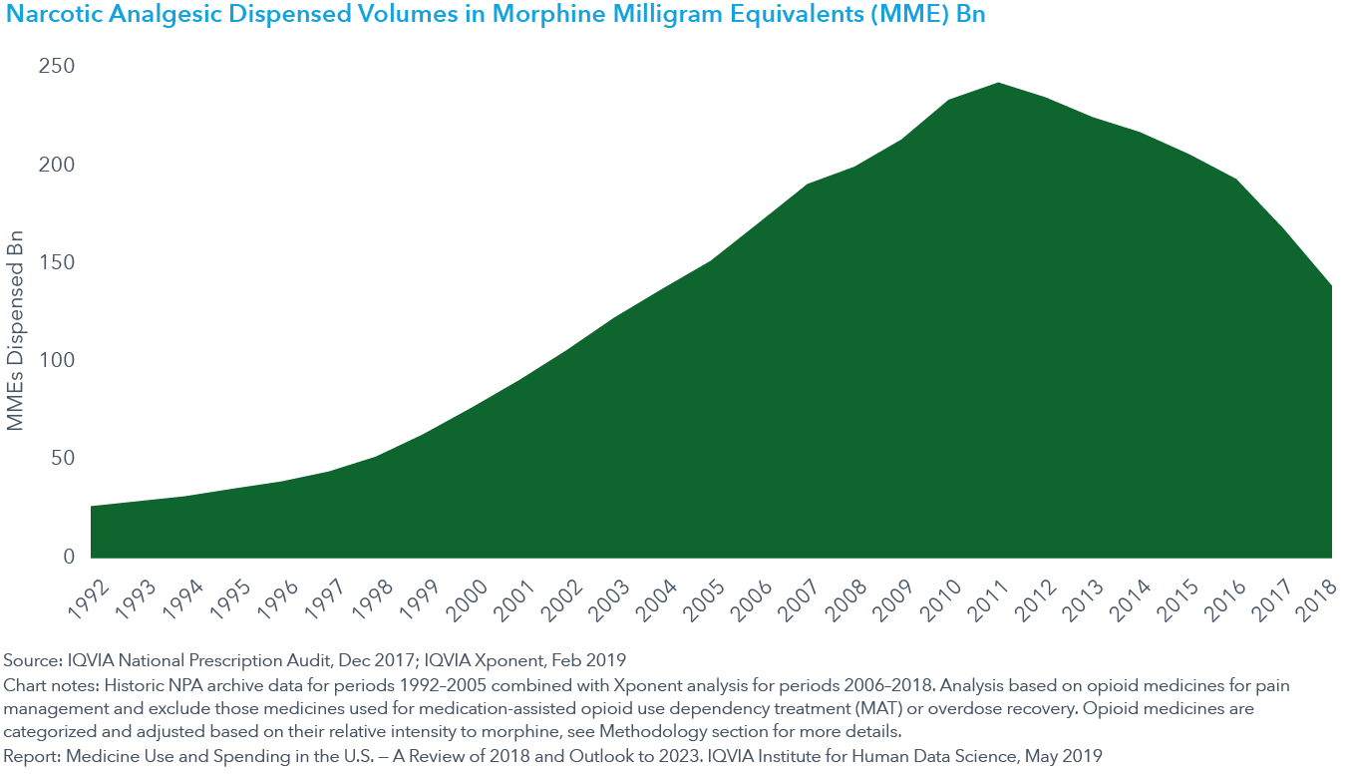
… is starting to have an effect
Notes:
And the good news is that the total number of opioids prescribed in America peaked in 2011 and has been declining since.

Slide 22
And is showing up “downstream”
Notes:
We are seeing the results of reduced prescribing showing up “downstream.” According to the Monitoring the Future survey, the percentage of 12th Graders who say that prescription pain medication is easy to get has dropped by almost half since 2010.

Slide 23
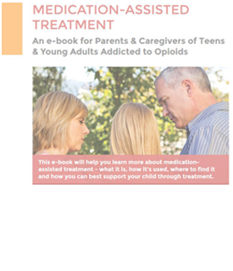
Medication-Assisted Treatment
Medication-Assisted Treatment (MAT) supports recovery from a substance use disorder
Medications, such as methadone, buprenorphine, Suboxone, Probuphine, Sublocade and Naltrexone/Vivitrol can reduce suffering from withdrawal and cravings for opioids
Some medications can be delivered in doctor’s offices
Learn more at drugfree.org/heroin
Notes:
Important to make sure people know about Probuphine (6-month implant) and Sublocade (one month depot shot) with benefit of not having to wait 7-10 days for vivitrol.
People may also ask about medical marijuana for OUD. Not studied but offered by some states regardless of the science

Slide 24
MAT increases by 80% in four years, while opioids drop
IQVIA, Medicine Use and Spending in the U.S., 2019
Notes:
The number of people participating in MAT doubled between 2015 and 2017.

Slide 25
Prescription Drug Monitoring Programs (PDMPs)
PDMPs can identify people who may be seeking opioid drugs inappropriately, or medical professionals who overprescribe
Currently, 49 states, the District of Columbia and one U.S. territory (Guam) have legislation authorizing the creation and operation of PDMPs
More work to be done …
Support efforts to share information between states
Encourage prescribers to use existing programs
Fully fund existing programs
Notes:
PDMPs, or Prescription Drug Monitoring Programs, can identify people who may be seeking opiate drugs inappropriately, or medical professionals who overprescribe.
Right now most almost all states have PDMPs. (Missouri is the only state the doesn’t).
[CLICK]
But right now, most state PDMPs can not “talk to each other.” Also, some states do not require prescribers to use the PDMP. Moreover, in some states PDMPs have been established but are not fully funded.

Slide 26
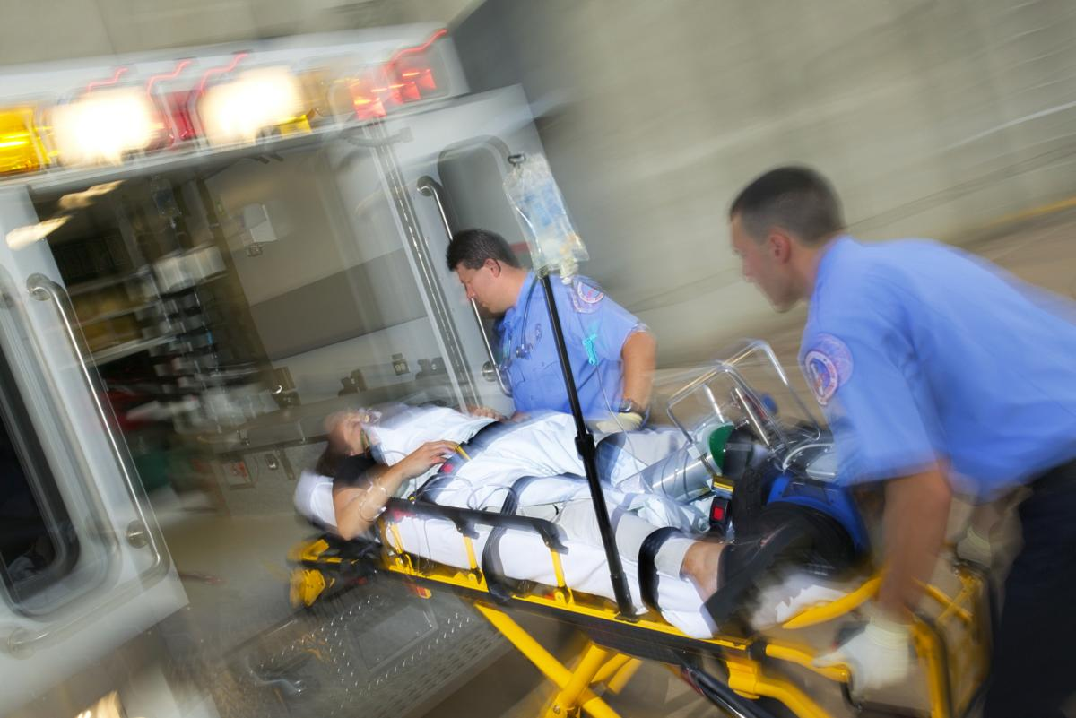
Good Samaritan Laws
Previously, companions of a person suffering a drug overdose would “dump” their “friend” at an emergency room
Good Samaritan laws provide legal immunity to an individual if they act to save the life of another person
Important for both people using opioids and family/friends to know about these laws
https://www.samhsa.gov/capt/sites/default/files/
resources/good-samaritan-law-tool.pdf
Notes:
Good Samaritan laws can save lives.
Good Samaritan laws provide legal immunity to a companion of a drug user if they act to save the life of another person. This is important because previously a person who was using drugs with a person who had an overdose would be reluctant to call 911 or take their friend to the hospital because they feared arrest.
Currently 32 states have some version of a Good Samaritan law, and the way the law works can vary from state to state.
A model Good Samaritan Law, covers people who are on parole or probation (many states do not). However, any law is only as good as it is implemented – if law enforcement, prosecutors and courts agree with not only the letter but the spirit of the law. Public promotion should also be part of a Good Samaritan Law because people will only use the law – and save lives – if they know about it.

Slide 27
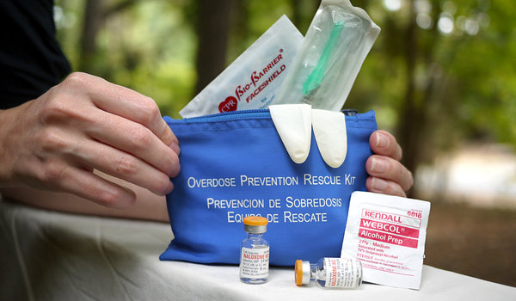
Naloxone
Naloxone, also known by the brand name Narcan, can save the life of a person experiencing an overdose
Naloxone counteracts opioids and can restore breathing and heart rate
49 states plus Washington D.C. permit Naloxone to be purchased without an individual prescription
What you can do …
If you are the loved one of a person who uses opioids, get a kit and get trained to use it
Advocate for affordable availability
http://pdaps.org/
Notes:
Naloxone can save lives if a person is having an overdose. Naloxone kicks opioids off of brain receptors and can restore breathing and heart rate.
Saving a life can be the first step towards putting the user on a path to recovery.
[CLICK]
It is a critical tool that is used by first responders, but the loved one of a person struggling with an addiction can also obtain a kit and learn to use it.
Naloxone use is expanding, but different states have different laws. Also, as demand has increased, supply and costs have been challenges that need to be addressed.

Slide 28
In your community …
What’s happening in Nevada?
Notes:
So those are some actions that communities are taking – what can you do as a family or individual?

Slide 29
Nevada Opioid Overdose Surveillance Dashboard opioid.snhd.org

Slide 30
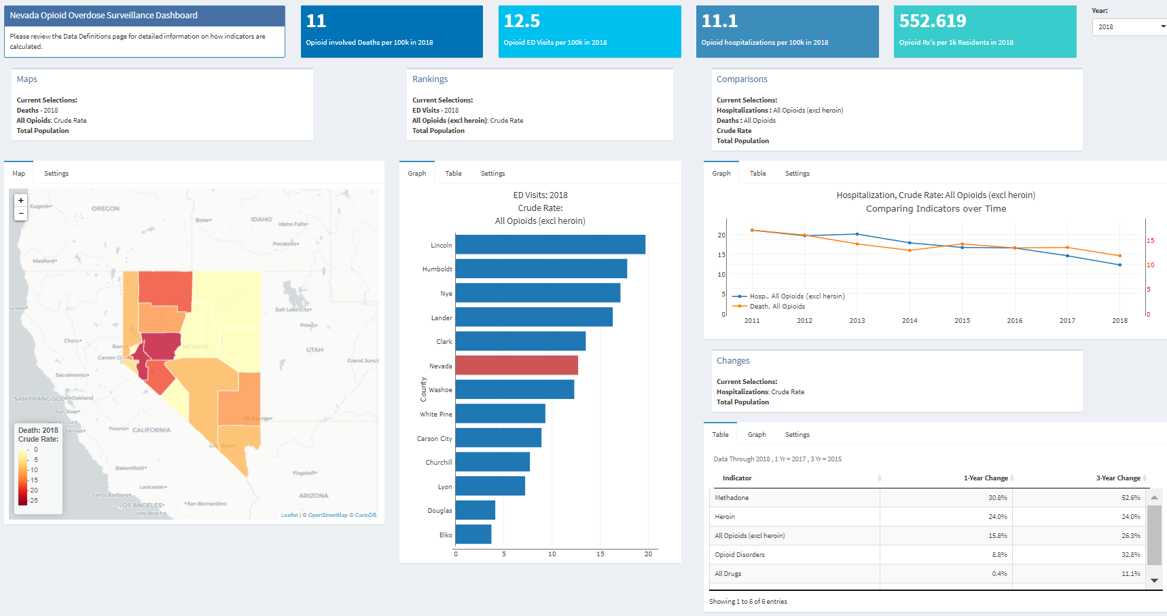
Nevada Opioid Overdose Surveillance Dashboard opioid.snhd.org

Slide 31
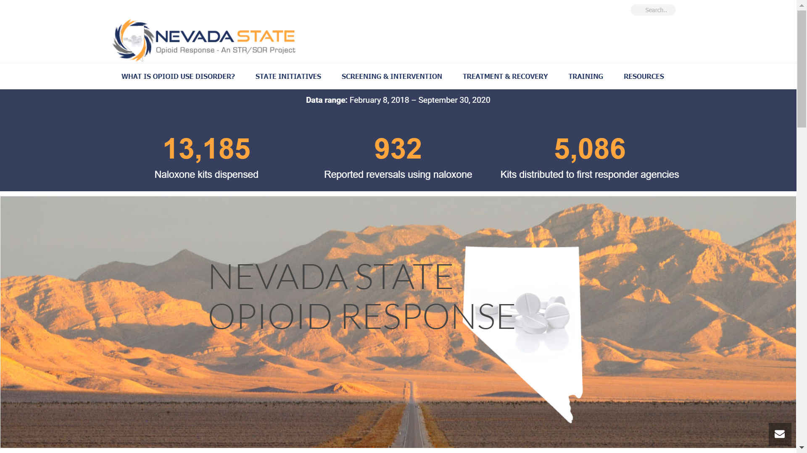
Nevada State Opioid Response nvopioidresponse.org

Slide 32
Nevada State Opioid Response nvopioidresponse.org

Slide 33
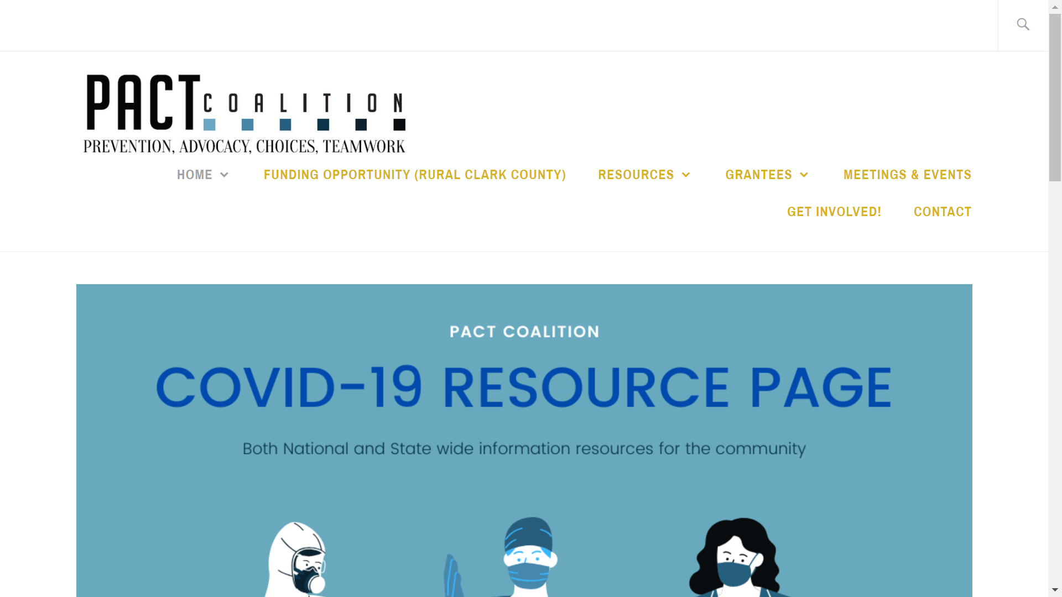
PACT Coalition drugfreelasvegas.org

Slide 34
wakeup-vegas.com

Slide 35
What you can do
Notes:
So those are some actions that communities are taking – what can you do as a family or individual?

Slide 36
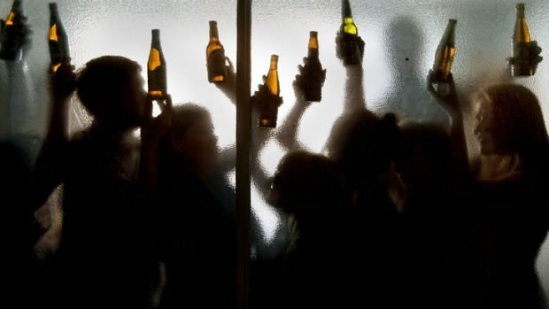
Protect your family – Take early use seriously
A person who starts drinking or using other substances before the age of 15 is five times as likely to develop a substance use disorder as person who starts at 21
The likelihood of lifetime substance use and dependence drops 4-5% for each year that initiation of substance use is delayed (SAMHSA, 2015)
Self-medication can start with alcohol and other substances and lead to opioids
Notes:
If you are a parent or a grandparent, or anyone who cares about a young person, I encourage you to get serious about substance use.
A person who starts using alcohol or other drugs before the age of 15 is five times as likely to develop a substance use disorder as person who starts at 21. AND the likelihood of lifetime substance use/dependence actually drops 4-5% for each year that initiation of substance use is delayed.
There are biological reasons for this … The human brain is not fully developed until the age of 24 or 25 and it is judgement that develops last. That’s the part of the brain that says “no, this is a bad idea” – which becomes further impaired by substance use.
Most kids who try alcohol or other substances will not develop an addiction, but all kids who use and misuse are putting themselves at risk – short term risk of accidents, injury, overdose, or simply bad decisions – and long term risk of a substance use disorder.

Slide 37
Protect your family – Talk
Kids who learn about the risks of substances at home are significantly less likely to use as those who don’t
Offer advice and guidance
Show concern rather than anger
Ask open-ended questions
Work to understand your teen’s point of view
Learn more on drugfree.org
Keep talking, no matter what
Notes:
You can protect your family by talking with your kids who you care about – from a young age to young adulthood.
Kids who learn about the risks of drugs at home are much less likely to use than kids who do not.
You can be clear about your expectations and boundaries, but still have a positive conversation that keeps the door open to further discussion. Some of the ways to do this are by:
* Offering advice and guidance rather than simply giving it. The phase “can I make a suggestion” – followed up by asking for their feedback – can go a long way.
* Teens can be frustrating – in many ways – but what you probably feel most for your teen is love and concern. Let them know that.
* Ask open ended questions. “Tell me about your night” vs. “Where were you”
* Again, it can be hard, but work to understand your teen’s point of view. Let’s say that your teen wants to go to a concert, but you don’t want them to go. You can say “help me understand … why is this so important to you?” It doesn’t mean that you will do what they want, but there is a better chance that they will feel heard.
* Finally, keep talking, no matter what. Maintaining some connection – even when a relationship is contentious, or if use does start – is very important. If you maintain a connection, you can always pull them back to where you want them to be.

Slide 38
Protect your family – Ask about alternatives
Ask your physician if an opioid is absolutely necessary
Understand that taking an opioid prescription increases risk for later addiction
Research alternative pain treatments
Discuss why you are looking into alternatives with your child
Acknowledge that some pain is okay. It tells us we need to care for ourselves.
www.cdc.gov/drugoverdose/pdf/nonopioid_treatments-a.pdf
Notes:
We respect medical professionals, but it is important to understand that we – as consumers and as our child’s best advocate – can and should ask questions about the best options for their long-term care and benefit.
You can ask your physician if an opioid is absolutely necessary
Highlight that taking an opioid prescription increases risk for later addiction too
Research alternative pain treatments
Discuss why you are looking into alternatives with your child
Highlight that some pain is okay. It tells us we need to care for ourselves. It is important to remember that many doctors were trained at a time when eliminating pain was a top priority.
The Centers for Disease Control and Prevention have developed a guide to non-opioid treatments that can be an important tool you can use to learn more about this issue.

Slide 39
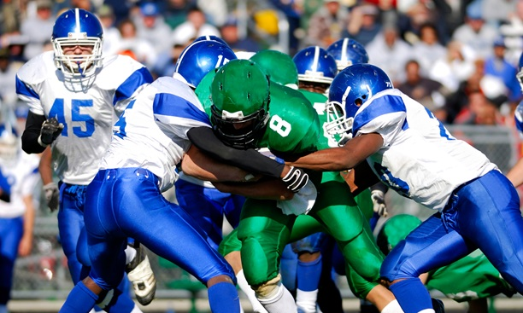
Protect your family – Monitor
Prescription medication misuse can start with sports injuries or dental work
In 2016, approximately 423,000 adolescents aged 12 to 17 misused prescription pain relievers for the first time
If your teen has been prescribed a medicine, be sure you control the medicine and monitor dosages
Ask if something other than opioids can be prescribed
Take note of how many pills are in each of your prescription bottles or pill packets
Keep track of your refills
Notes:
One way in which prescription drug misuse can start is with a sports injury or dental work. A teen is prescribed an opioid painkiller and they find that they like it and start to misuse it. Or, they may have a friend who asks them to share their medication.
That is why it is important for you control the medicine, monitor how many are being taken.
Keep track of how many pills are in each bottle and if you seem to be refilling medications more quickly than makes sense – there may be a problem.

Slide 40
Protect your family – Look for signs of use
Constriction of the pupils for a few hours or up to a day after use depending on which substance they are using
Shallow breathing and signs of disorientation
Drift into and out of consciousness, sometimes with excessive yawning, also referred to as “nodding off”
https://www.thefix.com/content/how-do-i-know-if-someone-addicted-heroin
Notes:
Other signs of use are pinpoint pupils and disorientation.
A user may drift in and out of consciousness and yawn a lot, which is known as nodding off.

Slide 41
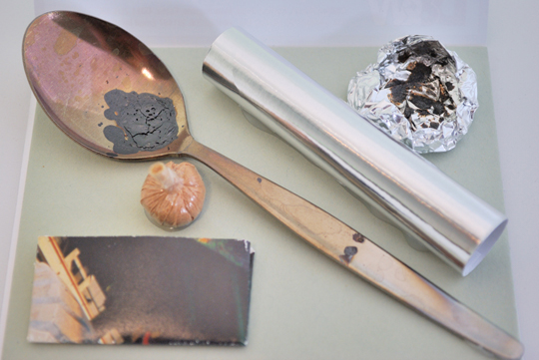
Protect your family – Look for signs of use
Emotional / physical signs of use
Behavioral changes
Track marks / long sleeves
Missing and/or burnt spoons or foil
Missing money or valuables
Trust your instincts & learn more at drugfree.org/heroin
Notes:
In addition to the signs of use we discussed before you may also see …
A dirty, unkempt appearance and general neglect of hygiene, which are strong indicators of drug use
They may appear depressed, and/or withdraw socially
And you may see track marks – which commonly occur on hands and arms (which is why they may wear long sleeved shirts even when it’s inappropriate for the weather). However, someone who has used for a while will inject anywhere they can find a vein.
You may find missing or burnt spoons, which are used to smoke heroin, or foil or missing money or valuables – heroin and pills aren’t free.
The best advice is to trust your instincts. If something doesn’t seem right, it very well may not be right. Show concern and ask questions.
There is a lot more information on this topic at drugfree.org/heroin.

Slide 42
Find answers
Notes:
As we learn about and take action against this issue, the Partnership for Drug-Free Kids can be a great resource.
The Partnership seeks to be the place where families find answers on all aspects of the drug issue.

Slide 43
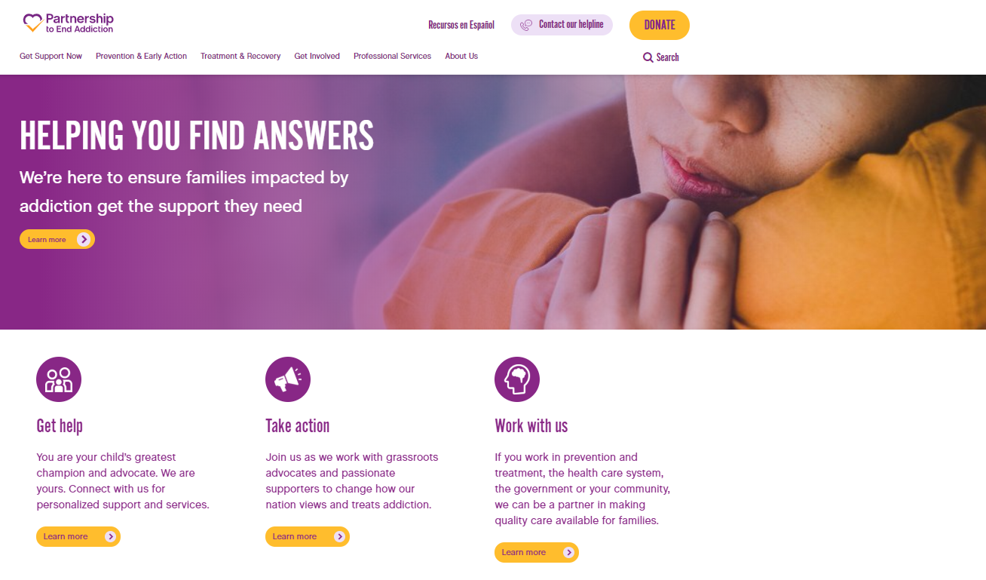
Find answers at drugfree.org
Notes:
The Partnership has a host of resources – from getting information about substance misuse to getting help to getting involved.
They do seek to be the place where families find answers.

Slide 44
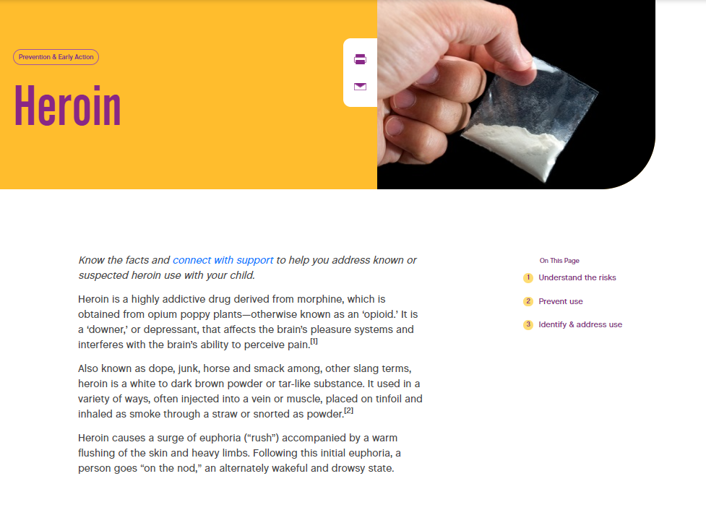
Learn more about heroin & other opioids at drugfree.org/heroin
Notes:
The Partnership has also established a special site dedicated to information about heroin and other opioids.

Slide 45
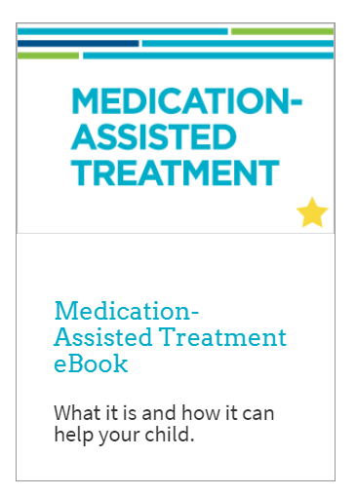
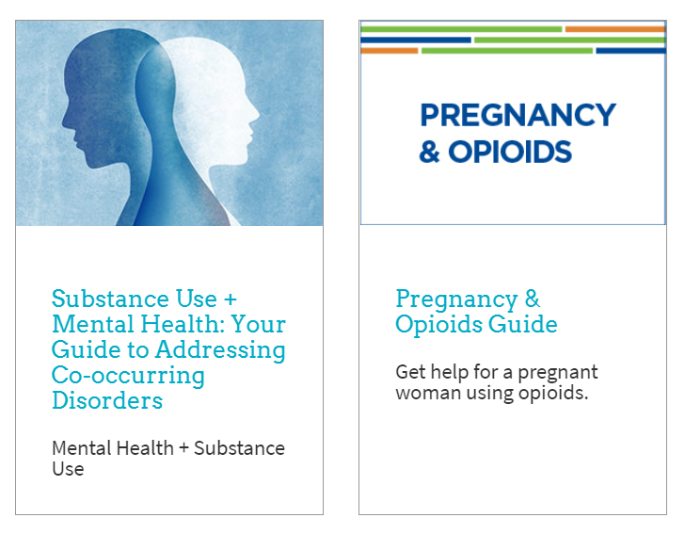
www.drugfree.org/resources

Slide 46
Get one-on-one support – drugfree.org/helpline
Notes:
If a person you care about is using opioids or any other drugs you can also connect with the Partnership’s Helpline via phone, live-chat, email, text, or Facebook messenger.
The Helpline is staffed by bilingual professionals who take the time to listen to your concerns and outline a plan of action. Families reach out for all kinds of reasons … from a parent who’s getting ready to have “the talk” with their teen to the parent of a 35 year old who is trying to support their recovery.
[CLICK]
Helpline Specialists can also help identify local treatment resources and share information about finding a treatment provider that will provide the services your loved one needs.

Slide 47
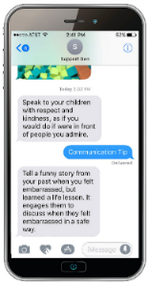
Help & Hope by Text
Engage
Assess & Personalize
Sustain: Adapt and Curate
Ongoing Personalization
Parents can decide to receive messages on any device using SMS, email or Facebook messenger
Adapt through a combination of automated and peer/coach real-time and ongoing support.
Assessment responses drive Personalized content is matched to each parent and child’s unique needs.
Notes:
The Partnership has a brand new resource for families: Help & Hope by Text.
Automated messaging program, where families can join, fill out a short assessment, and begin to receive personalized feedback.
It is an interactive, HIPAA compliant platform that offers individual and curated group support.
Text messaging
Health
Parenting
Kids
Risk behaviors
Schools
Teachers

Slide 48
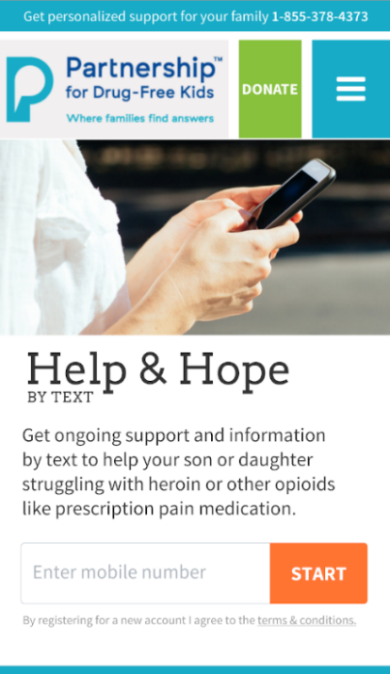
Text “Join” to 55753
You can love your child and dislike his behavior at the same time. You can reward positive behavior with love and acceptance no matter where they are in their journey.
H
Treatment advice.
Invite your child to be a participant in creating a plan to feel better and stop using. Together, plan out some tangible next steps you can take to get more information about opioid treatment options.
H
Click here schedule a chat session with a coach about navigating the treatment system based on your individual needs.
H
Notes:
Text Join to 55753, complete the short assessment, and start receiving customized messages.

Slide 49
Parent Coaching: Offering peer-to-peer support
Trained, volunteer Parent Coaches who have personal experience with a child’s substance use disorder provide coaching to parents now in that situation
Coaching happens by phone – usually about five times over a period of 6 weeks
Parent Coaches listen to the parent seeking support and help the parent find ways to help their family and themselves
Notes:
Beyond the Helpline, the Partnership has also established a Parent Coaching program.
Parent volunteers – all of who have some personal experience with a child’s substance use – talk to parent callers on the phone, usually about five times over a six week period.
Parent Coaches thoughtfully offer ideas to help the parent help their family and help themselves.

Slide 50
Resources in your community
Treatment: If someone is seeking treatment, where can they go? Who can they (or their family) talk to?
Prevention: What are the prevention programs in your community? How can they be supported?
Community Involvement: What activities / programs are alternatives for young people
Advocacy: What organizations are working to change policies to effectively respond to the opioid crisis?
Notes:
[YOU CAN USE THIS SLIDE TO IDENTIFY RESOURCES IN YOUR COMMUNITY. ]

Slide 51
Questions, comments?

Slide 52
Kevin Collins kcollins@toendaddiction.org Madison Moore mmoore@toendaddiction.org

Slide 54
Thank you …
A comprehensive law enforcement and prevention “360 Strategy” to help cities dealing with a heroin and prescription drug misuse epidemic, and its associated violent crime
"Investing in partnerships to build safe and healthy communities"

